Slide 1
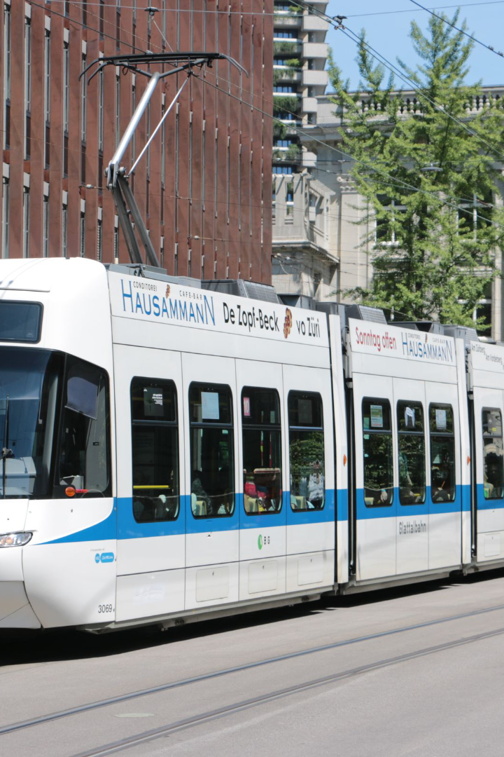
Problem Definition and Design Thinking for Public Transportation and Efficiency Analysis
In this part, we will delve into the problem statement and outline our design approach to solving the challenges in public transportation. Through thorough analysis and innovative thinking, we aim to enhance the overall transportation experience.

Slide 2
Problem Definition
The Objective
Analysis Goals
To assess service efficiency, on-time performance, and passenger feedback in public transportation.
Define specific objectives, such as evaluating on-time performance, passenger satisfaction, and overall service efficiency.
Data Collection
Visualization Strategy
Identify sources for transportation data, including schedules, real-time updates, and invaluable passenger feedback.
Plan the creation of informative dashboards and reports using IBM Cognos.

Slide 3

Design Thinking
1
Analysis Objectives
Set clear goals and objectives for your design project.
2
Data Collection
Gather relevant data and insights about your target audience.
3
Visualization Strategy
Create visual representations to better understand your research findings.
4
Core Integration
Integrate user feedback and insights into your design solution.

Slide 4
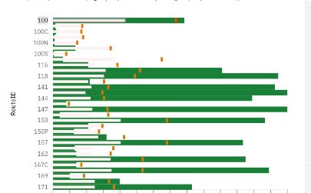
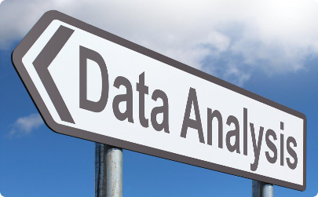
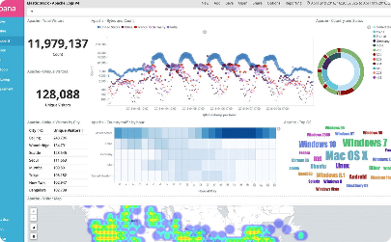
Collecting Transportation Data
Sources & Methods
Data Analysis
Informative Dashboards
Identify and gather data from various sources, such as schedules, real-time updates, and passenger feedback.
Apply analytical techniques to uncover insights and patterns within the collected transportation data.
Visualize the collected data through intuitive dashboards for easy interpretation and decision-making.

Slide 5
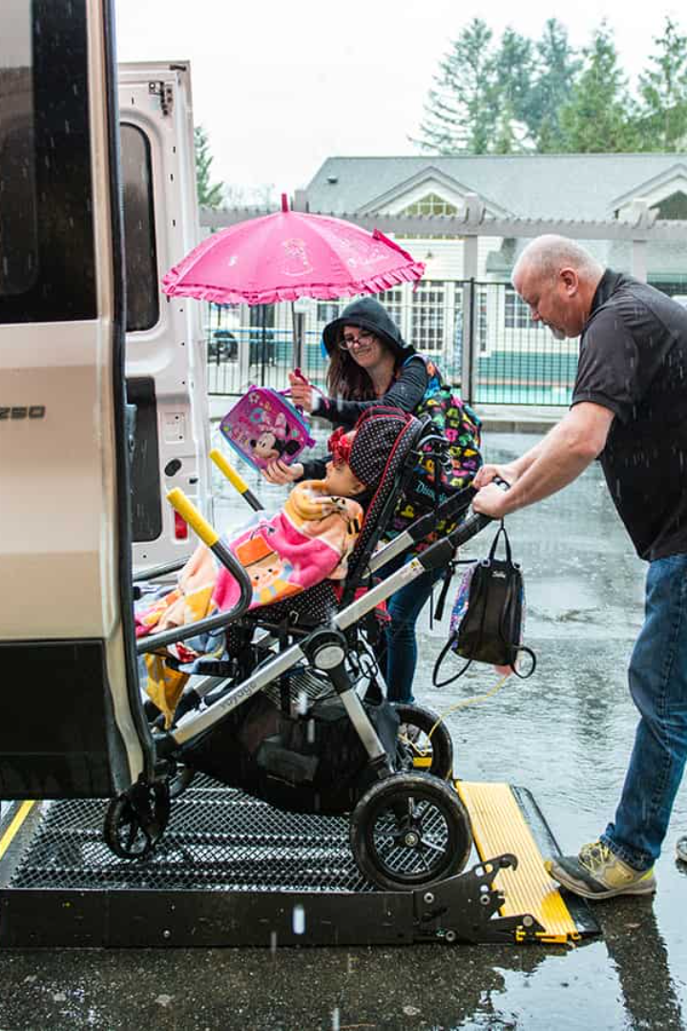
Enhancing Service Efficiency
1
On-Time Performance
2
Passenger Satisfaction
Evaluate passenger feedback to gain insights into their satisfaction and uncover opportunities for better service.
Assess and analyze the punctuality of public transportation services to identify areas for improvement.
3
Service Improvement
Identify potential areas where service can be enhanced, leading to a better overall transportation experience.

Slide 6
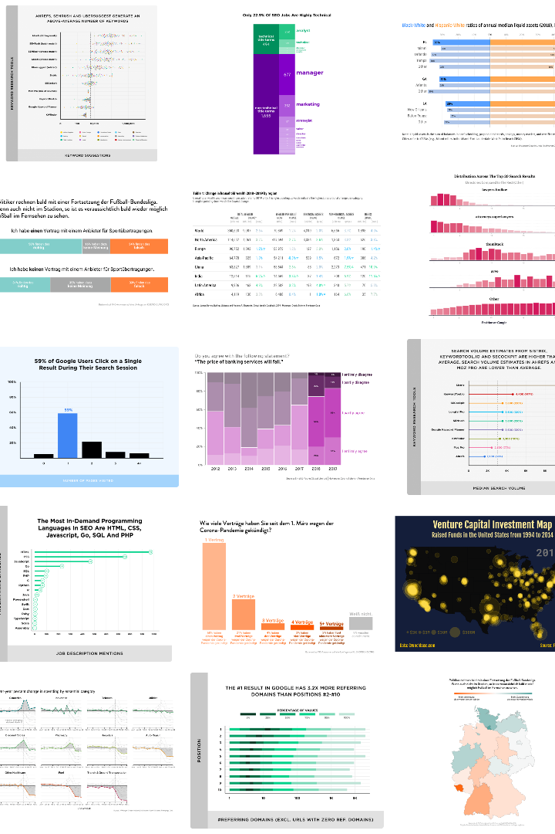
Visualization with IBM Cognos
Data Analysis
Interactive Dashboards
Informative Reports
Leverage the capabilities of IBM Cognos to analyze transportation data and extract meaningful insights.
Generate comprehensive reports that highlight key findings and support decision-making processes.
Create visually appealing and interactive dashboards that present complex data in a user-friendly manner.

Slide 7
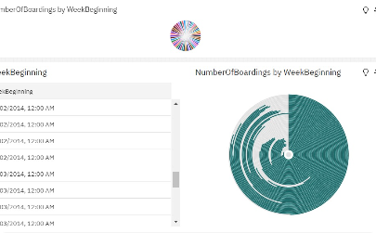
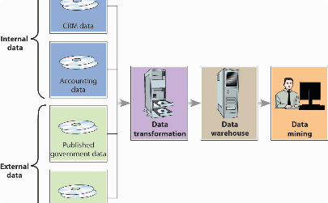
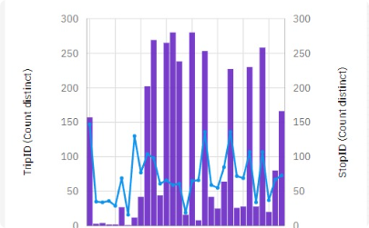
Data Cleansing & Transformation
Data Cleaning
Data Transformation
Statistical Analysis
Ensure accurate and reliable data by cleaning and removing inconsistencies, outliers, and inaccuracies.
Transform raw transportation data into a structured format suitable for analysis and visualization.
Apply statistical techniques to make meaningful inferences and draw actionable conclusions.

Slide 8
Improving Public Transportation Experience
1
Efficient Routes
Identify and optimize routes for improved efficiency, shorter travel times, and reduced congestion.
Real-Time Updates
2
Implement real-time updates to keep passengers informed about the status of their routes and available services.
3
Feedback
Encourage and leverage passenger feedback to continuously enhance and tailor transportation services.

Slide 9
Building Data-Driven Solutions
Informed Decision-Making
Service Optimization
Empower stakeholders with data-driven insights to make informed decisions for transportation improvements.
Identify areas of improvement to optimize public transportation services for enhanced efficiency and reliability.
Enhanced Passenger Experience
Future Growth & Expansion
Tailor transportation services by focusing on passenger needs and preferences for an improved travel experience.
Support future growth and expansion plans by leveraging data insights to meet changing transportation demands.

Slide 10

Summary and Conclusion
1
Analyzing Public Transportation
2
Optimizing Efficiency
Improving service efficiency and on-time performance leads to a reliable and convenient transportation experience.
By analyzing data and listening to passenger feedback, we can enhance public transportation services.
3
Empowering Decision Makers
Data-driven insights empower decision makers to implement effective strategies for transportation improvements.

Slide 11

Conclusion
Through the analysis of public transportation data, we can identify areas that require improvement and support transport improvement initiatives. Effective data visualisation strategies and code integration will simplify complex transportation data analysis and provide actionable insights for public transportation improvement.

